Slide 1


Wrist Anatomy
PT4050 / PT7001
Paul Starrs
P.Starrs@londonmet.ac.uk

Slide 2
LEARNING OUTCOMES
List the bones and joints of the wrist
Give an account of the wrist joint and its movements
Be aware of the importance of the triangular disc, and the Triangular Fibrocartilaginous complex (TFCC)
List the attachments of the flexor retinaculum
Know the boundaries and content of the carpal tunnel
Differentiate between extrinsic and intrinsic ligaments
Briefly describe the arrangement of the carpal ligaments, and the consequences of their instability
Describe the common wrist injuries

Slide 3
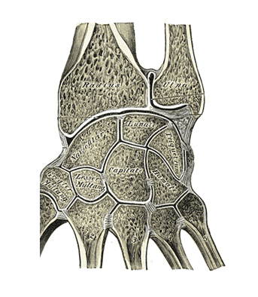
JOINTS
Inferior Radio-Ulnar joint
Radio-Carpal joint

Slide 4
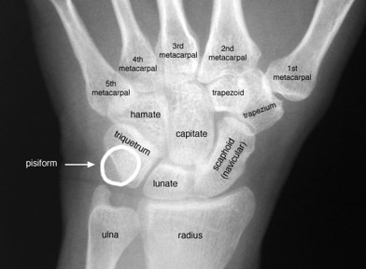
BONES
Proximal row of carpals
  Scaphoid
  Lunate
  Triquetrum
  Pisiform
Radius
Ulnar

Slide 5
INFERIOR RADIO-ULNAR JOINT
The interosseous membrane is a thin fibrous sheet that connects the radius and ulnar and aids in transfer of forces between the two bones
A synovial pivot joint formed by the head of the ulnar and the ulnar notch of the radius
Assists the superior radio-ulnar joint with pronation and supination

Slide 6
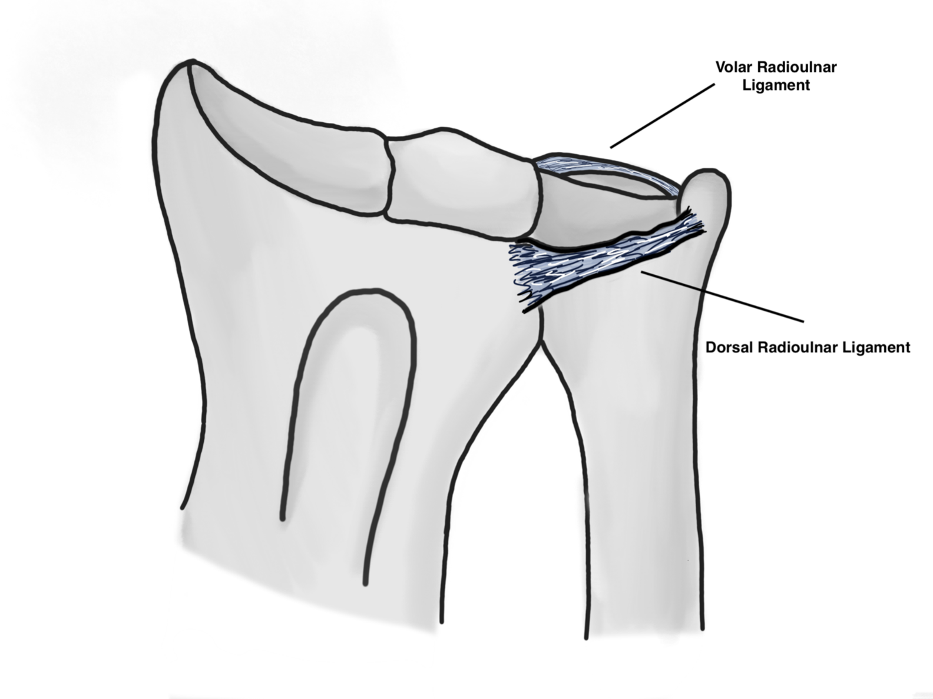
INFERIOR RADIO-ULNAR JOINT
Supported anteriorly and posteriorly by the volar (or palmar) and dorsal radio-ulnar ligaments

Slide 7
TFCC
Triangular fibrocartilage complex (TFCC) is a load-bearing structure between the lunate, triquetrum, and ulnar head
The function of the TFCC is to act as a stabilizer for the ulnar aspect of the wrist

Slide 8
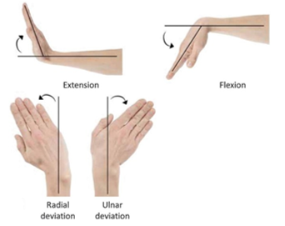
RADIOCARPAL JOINT
The wrist is an ellipsoidal (condyloid) type synovial joint, allowing for movement along two axes
Compromised of the distal end of the radius (and ulnar) and the proximal row of carpals
Produces flexion, extension, ulnar deviation and radial deviation

Slide 9
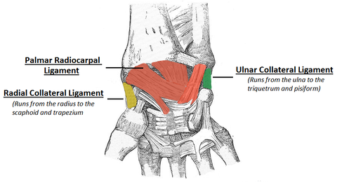
RADIOCARPAL JOINT
The dorsal aspect of the wrist includes the dorsal radiocarpal ligament

Slide 10
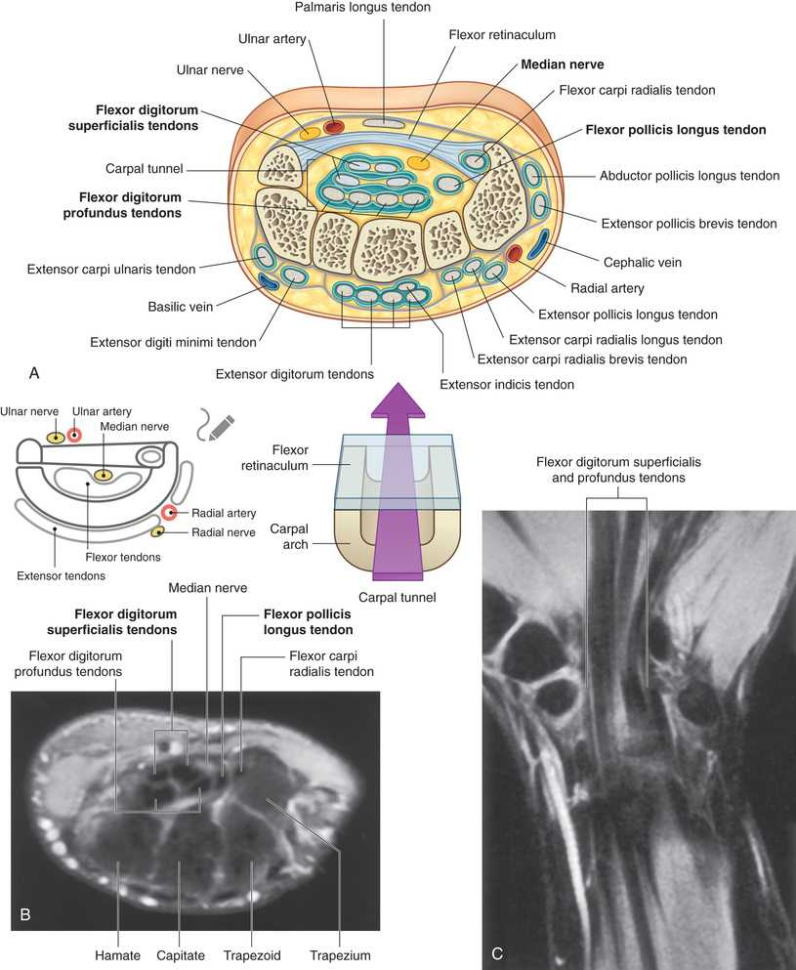
CARPAL TUNNEL
The flexor retinaculum is a thick connective tissue ligament that bridges the space between the medial and lateral sides of the base of the carpal arch (Scaphoid to Pisiform and Trapezium to Hamate)
Converts the carpal arch into the carpal tunnel
It also holds the flexor tendons close to radio-carpal joint

Slide 11
CARPAL TUNNEL
The four tendons of the flexor digitorum profundus, the four tendons of the flexor digitorum superficialis, and the tendon of the flexor pollicis longus pass through the carpal tunnel, as does the median nerve

Slide 12

ANY QUESTIONS?

Slide 13
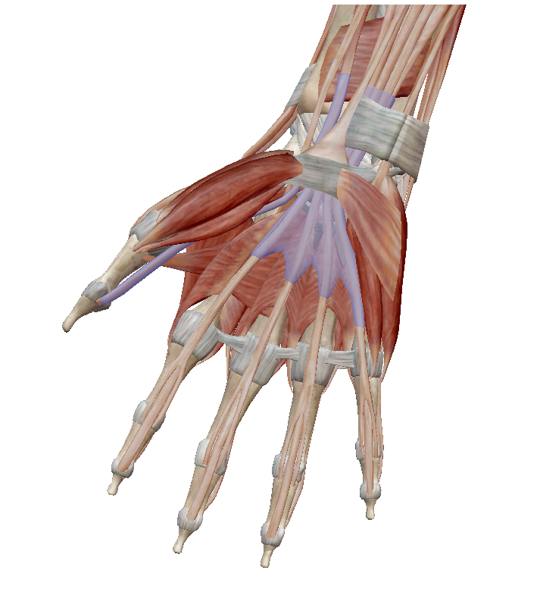
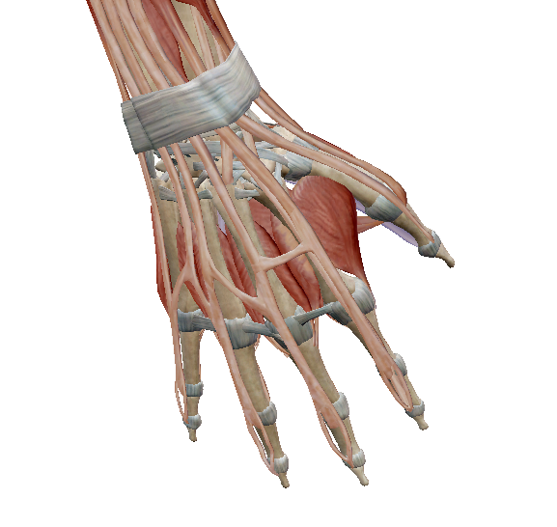
MUSCLES
Notes:
Can be divided up into intrinsic and extrinsic muscles

Slide 14
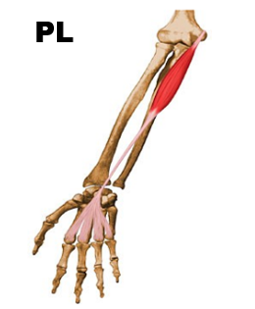
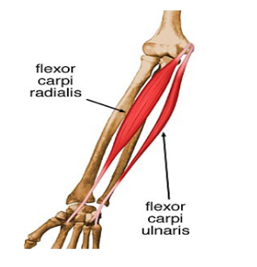
MUSCLES
FLEXORS OF THE WRIST
Flexors originate from the medial epicondyle of the humerus
  Flexor carpi radialis
  Flexors carpi ulnaris
  Palmaris longus

Slide 15
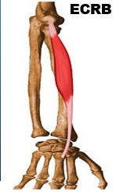
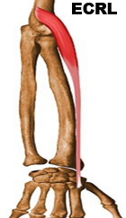
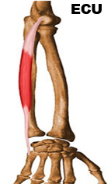
MUSCLES
EXTENSORS OF THE WRIST
Extensors originate from the lateral epicondyle of the humerus
  Extensor carpi radialis longus
  Extensor carpi radialis brevis
  Extensor carpi ulnaris

Slide 16
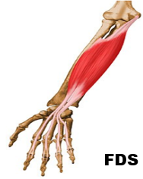
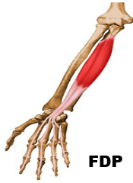
MUSCLES
EXTRINSICS OF THE FINGERS
Extrinsic muscles of the wrist and hand originate in the forearm and include:
  Flexor digitorum superficialis
  Flexor digitorum profundus (Latin for deep)

Slide 17
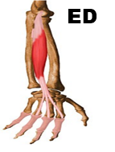
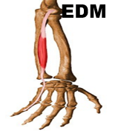
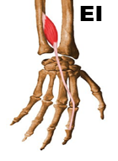
MUSCLES
EXTRINSICS OF THE FINGERS
Extensor digitorum
Extensor digiti minimi
Extensor indicis
Dorsal digital expansion, sometimes referred to as the ‘extensor hood’, holds the extensor tendons in place beyond the PROXIMAL INTERPHALANGEAL (PIP)
DORSAL DIGITAL EXPANSION

Slide 18
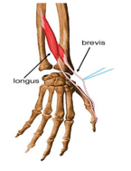
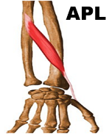
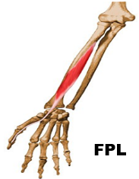
MUSCLES
EXTRINSICS OF THE THUMB
Extensor pollicis longus
Extensor pollicis brevis
Abductor pollicis longus
Flexor pollicis longus

Slide 19
ANY QUESTIONS?

Slide 20
CARPAL TUNNEL SYNDROME
Carpal tunnel syndrome is an entrapment syndrome caused by pressure on the median nerve within the carpal tunnel
Usually, a direct effect of increased pressure on the median nerve caused by overuse, swelling of the tendons and tendon sheaths and cysts arising from the carpal joints

Slide 21
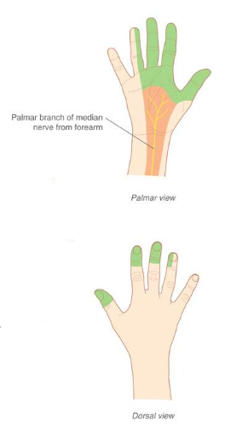
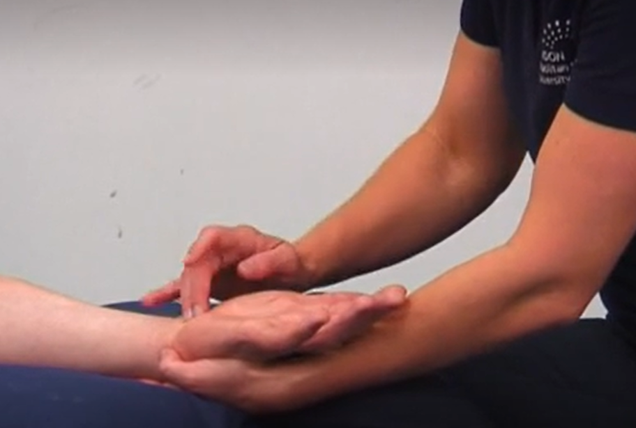
CARPAL TUNNEL SYNDROME
Patients typically report pain and pins-and-needles sensations in the distribution of the median nerve
Weakness and loss of muscle bulk of the thenar muscles (those at the base of the thumb) may also occur
Gently tapping over the median nerve readily produces these symptoms
Initial treatment is aimed at reducing the inflammation and removing any repetitive actions that produce the symptoms
If this does not lead to improvement, nerve conduction studies will be necessary to confirm nerve entrapment, which may require surgical decompression of the flexor retinaculum

Slide 22
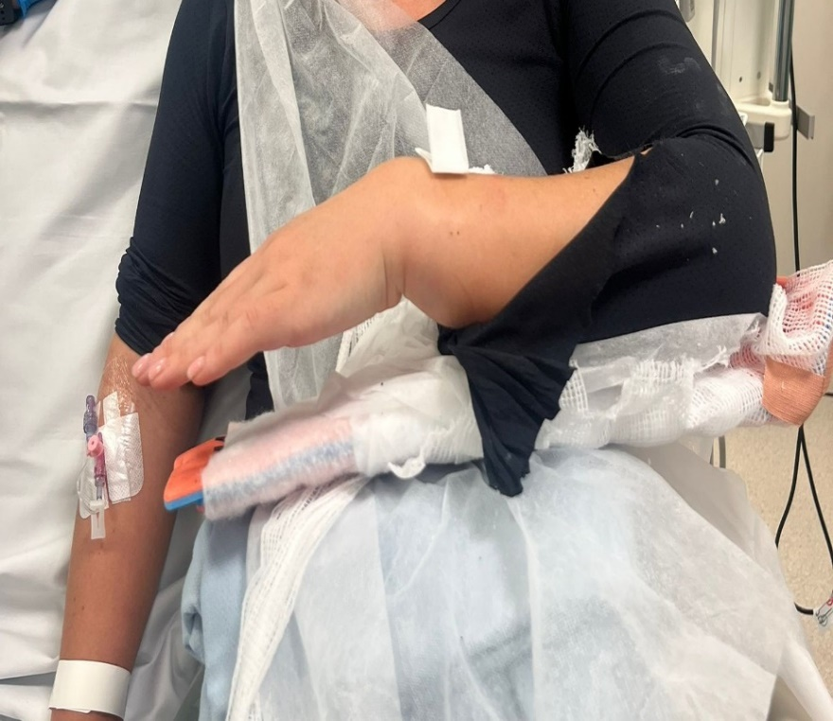
COLLES’ FRACTURE
Alternative name for a distal radius fracture (when there is displacement), which are common following a fall onto an outstretched hand (FOOSH)
Characterised by posterior displacement of the distal end of the radius

Slide 23
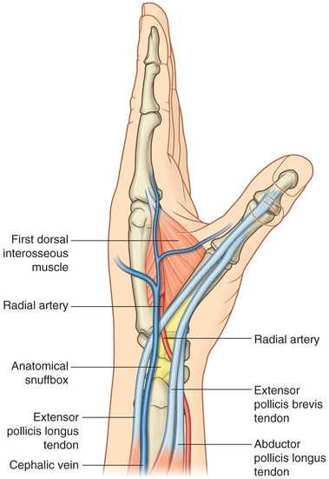
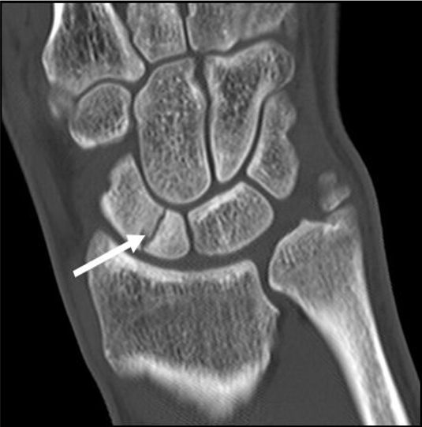
SCAPHOID FRACTURE
Common following a fall onto an outstretched hand (FOOSH)
Occurs at the ‘waist’ of the scaphoid
Pain usually present on palpation of the ‘snuffbox’
In 10% of the population, the scaphoid has one vessel of blood supply (scaphoid branch of the radial artery) which can cause avascular necrosis, if the scaphoid fractures and is not recognised and managed
Other issues include onset of wrist arthritis later
FOOSH can sometimes lead to a scapholunate ligament rupture which causes instability symptoms

Slide 24
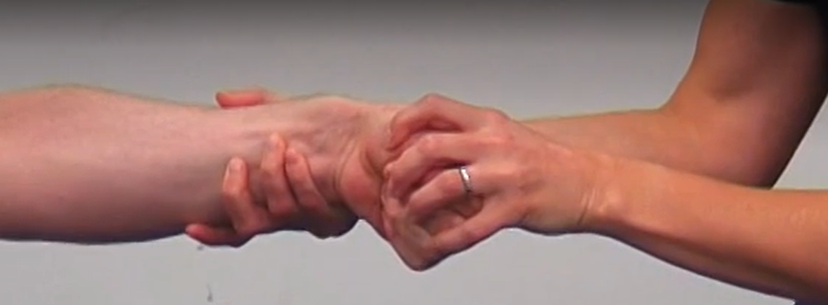
DE QUERVAINS SYNDROME
De Quervain's syndrome is an inflammatory disorder that involves the extensor pollicis brevis tendon and abductor pollicis longus tendon
Patients typically present with significant wrist pain preventing flexion/extension and abduction of the thumb
The cause of this disorder is often overuse and is common in new mothers who are constantly lifting young children
Identified using Finklestein’s test

Slide 25

QUIZ

Slide 26
SUMMARY
The wrist complex is made up of the radius, ulnar and proximal row of carpals
Supported by articular disc, TFCC and ligaments
Many structures are present in a small space and some of these (flexor tendons and median nerve) run through the carpal tunnel
Common traumatic injuries include distal radius and scaphoid fractures
Common insidious injuries include carpal tunnel and De Quervains syndromes

Slide 27
ANY QUESTIONS?

